Slide 1

PCAN Programming
Introduction to Programming for CAN
Project VI
(Peter Roeser – modified by Michael A. Galle)
Notes:
S6P1W02F7 Software Systems (SENG3010) Programming for CANMath For Networking Project 3 Week 8 Focus 1S5P3W04F3 Quality - Development Plans and the ISO Process
Math For Networking Project 3 Week 8 Focus 1S5P3W04F3 Quality - Development Plans and the ISO Process

Slide 2
Today
Introduction to Programming for CAN
  Windows
    PCAN-View
    Program API
    Test Programs
  Linux
    Building Driver
    Installing
    Test Programs
    Program API
Notes:
S6P1W02F7 Software Systems (SENG3010) Programming for CANMath For Networking Project 3 Week 8 Focus 1S5P3W04F3 Quality - Development Plans and the ISO Process
Math For Networking Project 3 Week 8 Focus 1S5P3W04F3 Quality - Development Plans and the ISO Process

Slide 3
Introduction to Programming for CAN
Notes:
S6P1W02F7 Software Systems (SENG3010) Programming for CANMath For Networking Project 3 Week 8 Focus 1S5P3W04F3 Quality - Development Plans and the ISO Process
Math For Networking Project 3 Week 8 Focus 1S5P3W04F3 Quality - Development Plans and the ISO Process
S5P3W04F3 Quality - Development Plans and the ISO Process

Slide 4
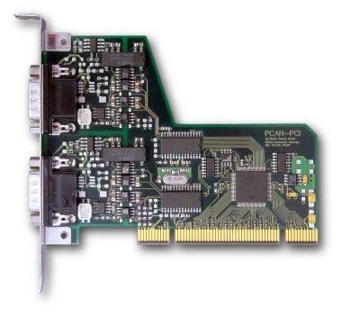
Peak PCAN-PCI Card
Connection of high-speed CAN (CAN specifications 2.0A and 2.0B) to PC
CAN transfer rate up to 1 MBit/s
Occupies one PCI Expansion card slot
Equipped with the CAN controller SJA1000T by Philips
CAN connection via 9-pin Sub-D male with pin assignment according to CiA recommendation DS102

Slide 5
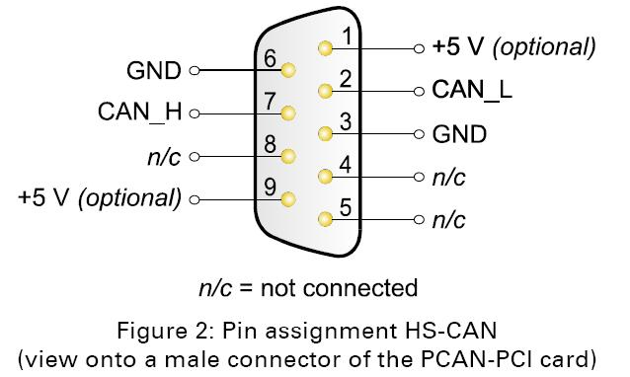
DB 9 Connector TO Bus
n/c
n/c
For our cards
  Single CAN interface
  No support for +5v at connector

Slide 6
Windows Installation Software
Can install older software from CD provided with cards or use the latest software available on the scratch drive
Installation includes PCAN-View for monitoring and interacting with CAN, example code, device driver for PEAK products including the pci based cards, and DLL’s to support the sample programs

Slide 7
PCAN-View
  Can be used to monitor or interact with CAN Bus
  Shows received messages in a receive list and will summarize repeated occurrences with receipt period and count
  Can transmit messages manually by entering into transmit list or can send periodically by setting a transmit period in ms.
  Transmit messages are sent automatically in response to a matching Remote Request Frame and marked with an “RTR” in the monitoring window
  For detailed information see PcanView.chm (Help File)

Slide 8
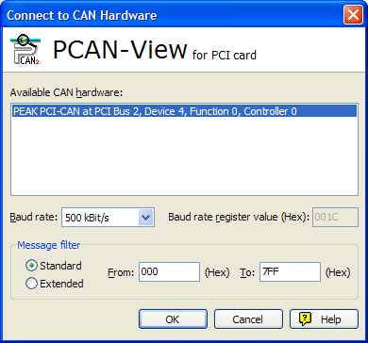
PCAN-View
  Main Start Screen

Slide 9
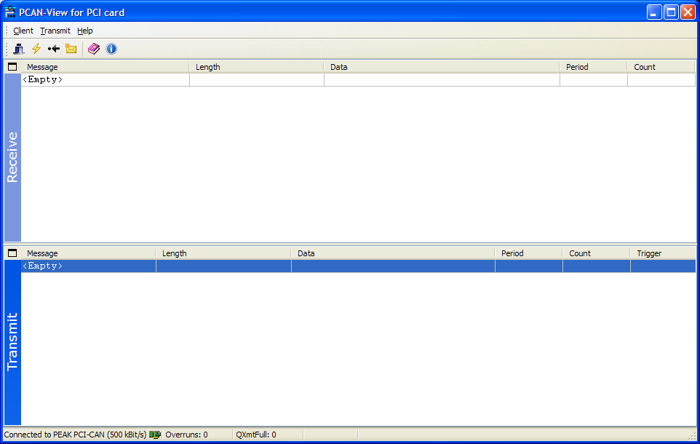
PCAN-View
  Main Message Control Screen

Slide 10
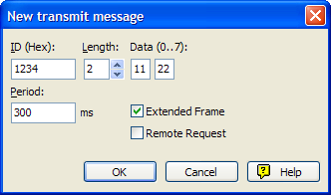
PCAN-View
  Create a Transmit Message Window
Software Systems (SENG3010) Programming for CAN

Slide 11
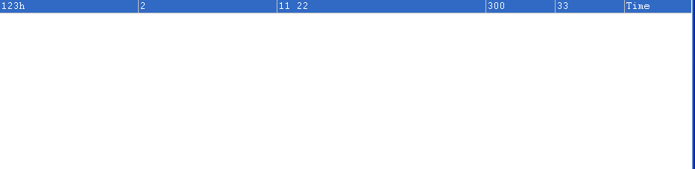
PCAN-View
  Repeated Transmit Message Monitor SubWindow Contents
  includes ID, Length of Data, Data, Period, Transmission Count, and Transmit Message Mode

Slide 12
Windows Programming API
  See PCANLight_enu.chm for information on Windows Programming API
  Must init driver and card interface
  Only one process can manage a CAN interface port at a time
  Can set up message filters
  Read and Write messages supported
  Messages are formatted according to the TPCAMMsg structure

Slide 13
Windows Programming API
  Functions are documented in the help file or header file Pcan_2pci.h
  Available Functions are:
    Init (for Plug and Play hardware or other)
    Close
    MsgFilter
    Read
    ResetClient
    Reset Filter
    Status
    VersionInfo
    Write
  Additional Functions are available for interacting with USB versions of Peak CAN hardware

Slide 14
Windows Programming API
  TPCAnMsg structure;
  typedef struct
  {
  DWORD ID;
  BYTE MSGTYPE;
  BYTE LEN;
  BYTE DATA[8];
  } TPCANMsg;

Slide 15
Windows Programming API (cont’d)
  MSGTYPE is a bit mask indicating the type of the message
Identifer | Value | Description
MSGTYPE_STANDARD | 00h | Data Frame. CAN message with data contents and an 11-bit CAN ID.
MSGTYPE_RTR | 01h | Remote Transmit Request (RTR).
MSGTYPE_EXTENDED | 02h | Data Frame. CAN message with data contents according to CAN 2.0B standard (29-bit CAN ID).
MSGTYPE_STATUS | 80h | Status message. The first 4 data bytes contain an Error Code. MSB of the Error Code is in data byte 0, LSB is in data byte 3.

Slide 16
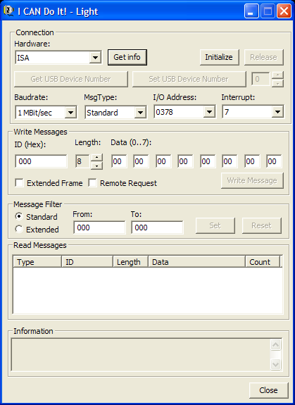
Windows Test Programs
  Beyond PCAN-View there are sample programs written for Delphi, C++ (MFC), VB, …
  The MFC application ICDLight is like a simplified version of PCAN-View.
  Note: I had to copy the PCAN dll files from the unpacked disk directories to my windows system32 directory so that the programs could run.

Slide 17
Questions?
?
Software Systems (SENG3010) Programming for CAN
Notes:
S6P1W02F7 Software Systems (SENG3010) Programming for CANMath For Networking Project 3 Week 8 Focus 1S5P3W04F3 Quality - Development Plans and the ISO Process

Slide 18
Linux Installation Software
Can install older software from CD provided with cards or use the latest software available on the scratch drive
Main issue after unpacking the source distribution is to build the driver code and examples
To build the driver requires the linux kernel headers since the driver is a kernel module that must be loaded into the kernel or compiled into it.

Slide 19
Building the Linux Driver
  To build the driver the headers or source used to build the kernel must be available. On the CLIP computers the headers are already available under the directory /usr/src
  The source for your version can be downloaded through the Synaptic Package manager or retrieved from the scratch drive for linux 2.6.27
  You should find different directories of the form
  linux.2.6.17-9-generic.headers in /usr/src
  However, since version numbers change with great regularity under linux, the standard approach to setting up access to headers is to create a soft link called “linux” in /usr/src that points to the header or source directory for the current kernel.
  How do we determine the current running version of the kernel?

Slide 20
Building the Linux Driver
  uname –r
  Returns the current running kernel version information.
  This should correspond to one of the header directories in /usr/src
  Create the link from /usr/src/linux to the appropriate directory.

Slide 21
Building the Linux Driver
  At the root directory of the driver, you should find a Makefile which now may run.
  If you get compile errors you may need to go into the driver directory and make a modification to the driver Makefile.
  Use your favorite editor (Mine is vi, so the following is based on vi)
    cd driver // go to the driver directory
    vi Makefile // edit the Makefile
    /KERNEL_LOCATION/ // find KERNEL_ LOCATION variable
    0lx // uncomment the line
    s/xxx/yyy/ // point to the actual header directory
    :wq // leave vi
    cd .. // return to base directory

Slide 22
Building the Linux Driver
  Commands to build and install the driver:
    cd peak-linux-driver-x.y
    make clean
    make
    su -c “make install”
  Or for the last command if you have sudo privileges
    sudo make install

Slide 23
Installing the Linux Driver
  The build process has created the driver module and test programs but not installed it in the current running kernel. To do so run:
  sudo /sbin/modprobe pcan
  To confirm that the module was installed type
  tail /var/log/messages
  And look for appropriate message indicating the installation of the PCAN module and that it found the PCI card such as:
    Mar 6 17:35:26 xxxx kernel: pcan: Release_20070221_n
    Mar 6 17:35:26 xxxx kernel: pcan: driver config [mod] [isa] [pci] [dng] [usb] [pcc]
    Mar 6 17:35:26 xxxx kernel: pcan: pci device minor 0 found
    Mar 6 17:35:26 xxxx kernel: pcan: pci device minor 1 found
    Mar 6 17:35:28 xxxx kernel: pcan: major 253.
  Note that the modprobe may have to be executed each time your machine is rebooted unless you do some more work to force it to happen on startup by linux.

Slide 24
Linux Programming API
  The CAN bus driver module works by creating a series of /dev/pcan* devices for each piece of Peak CAN hardware that it finds.
  The particular number of the device is according to the interface type. In the case of the PCI cards, the device created is /dev/pcan0
  Communication with the driver module is by writing special sequences of ascii strings. In other words it acts very much like a terminal interface that is line buffered.
  A simple method to receive message from the CAN bus would be to type:
  cat /dev/pcan0
  To send a message, you could type:
  Echo “m s 0x234 2 0x11 0x22” > /dev/pcan0
  This would send a CAN data frame with id 0x234 and 2 bytes of data consisting of 0x11 and 0x22
  Simple, eh?

Slide 25
Linux Test Programs
  There are two test programs created when the driver module is built: receivetest and transmitest
  receivetest is a simple C program, while transmitest is written in c++, but the principles remain the same from what was shown on the previous slide.
  To invoke the details of each test program us the -? Or –help options on the command line.
  There are many options, but the main one that will be important is to set the CAN baud rate. The baudrate that corresponds to a particular input value must be looked up from a table. For example –b 0x1c sets the CAN baudrate to 500kb

Slide 26
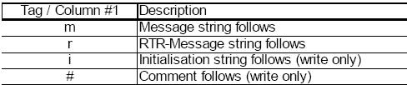
Linux Test Programs
  The first item on the ascii line sent to or received from the /dev/pcan0 device determines the type of the message:

Slide 27
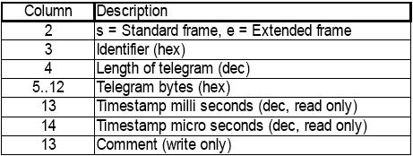
Linux Test Programs
  The remaining items of the message are:

Slide 28
Further Reading
Peak Documentation Set
  Windows installation manual
  Linux installation manual
  PCI Card Manual

